Slide 1

ENGL155 – project
SPSE / SPRE
University of Bahrain
Department of English language & literature
Semester 2, 2022 / 2023
Karim Agha Qizalbash

Slide 2
overview
What is SPSE / SPRE
How it applies to your project
A note on working in teams
How you will be assessed
Key points
Questions

Slide 3
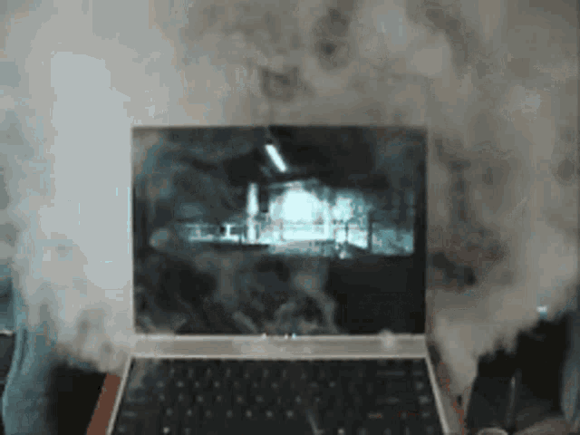
S
You open your laptop and this happens…
What’s the problem?
Hard drive overheated?
Broken fan?
You spilt water on it?
A short-circuit?
A bug has infiltrated the chipset causing the motherboard to cease communicating with the BIOS. The cooling fan won’t switch on and the hard drive malfunctions...
NONE of the above.
This is the SITUATION – You have a broken laptop

Slide 4

P = Problem
S – Situation
P - Problem
So, what is the problem?
You can’t do your assignment!
You will fail the course!!
You will be kicked out of UOB!!!
You will not get a good job!!!!
You cannot get married!!!!!
No children!!!!!!
…
This is clearly an exaggeration, but you get the point.
شو سوي

Slide 5
Find Solutions
S – Situation
P – Problem
S – Solution(s)*
Buy a new laptop
Borrow a laptop from someone
Go to Bluebell on Budaiya Highway to get it repaired
Get someone to do the assignment for you
Try to fix the laptop yourself
???
What’s the best solution?

Slide 6
Evaluation of solutions
S – Situation
P – Problem
S – Solution(s)*
E - Evaluation
BUY NEW
+ quick
+ new and improved
+ last longer
- expensive
- could have used the money for something else
BORROW
+ quick
+ no cost
- have to give it back
- laptop still broken
REPAIR
+ cheaper than buying new
+ supports local business
+ laptop now working
- may not last as long as a new laptop
- will take longer than buying new
FRIEND DOES FOR YOU
+ quick
+ no cost
+ you can sleep!
- it’s cheating!
- laptop still broken
FIX IT YOURSELF
+ cheaper
+ you’ll learn something new
+ satisfaction!
- may make it worse
- watch hundreds of Youtube videos
- longer time
SO???

Slide 7
Now you try
S – Situation
P – Problem
S – Solution(s)*
E – Evaluation
* sometimes known as RESOLUTION(S)
S – Traffic in Bahrain
P – ?
S – ?
E – ?

Slide 8
YOUR PROJECT
Apply the SPSE / SPRE model to a situation of your choice
It could be anything anywhere – ideally something you are interested in
You will present your ideas as a group using some form of digital media. The presentation should last approximately 10 minutes.
YOUR TEACHER WILL GIVE YOU THE FULL PROJECT OUTLINE PDF

Slide 9
WORKING IN teamS
Choose your teams wisely – minimum 3 / maximum 4.
We understand that issues may arise with some team members doing more/less work than others. This is reality - it happens in all walks of life.
Teamwork, cooperation, leadership, organisation, time-management, people skills, empathy, support, etc. are all important life skills.
Remember – if you want the rose, you must also take the thorns.

Slide 10
How you will be assessed
There are five key areas that will be assessed:
  research
  use of digital media
  organisation of your ideas
  effectiveness of your delivery
  use of language
  The first three points will be a shared mark among the team members, i.e. you will all get the same mark.
  The last two points will be marked on an individual basis.
  Please carefully read the assessment criteria in the project instructions

Slide 11
Key points
pick your teams asap
think of the SITUATION that you want to investigate
start your research early
you will need to have evidence of research in week 9 – checked by your teacher and worth 5% of your final mark
you will deliver the presentation to the whole section in week 14. The presentation is worth 15% of your final mark

Slide 12
If you look back at the Global Cities report, you will notice that the report was structured using the SPSE model:
Situation: The large number of migrant workers in London
Problem:
- underpaid
- poor working conditions
- lack of benefits
- (misrepresented by the media)
Solutions:
- Living Wage Campaign
- unionisation
- development of future leaders to represent migrant workers
- Living Wage Unit
- increased wages
Evaluation:
- a welcomed improvement
- will be hard to implement
- London’s reputation at risk
- multiple parties need to address the issues

Slide 13
questions
© Karim Agha Qizalbash
Linking English
link-eng.co.uk
support@link-eng.co.uk

